Slide 1
Customer Churn Prediction - MLOps Project
Vishal Nigam | Data Engineer
University of Trieste
SM3800014

Slide 2
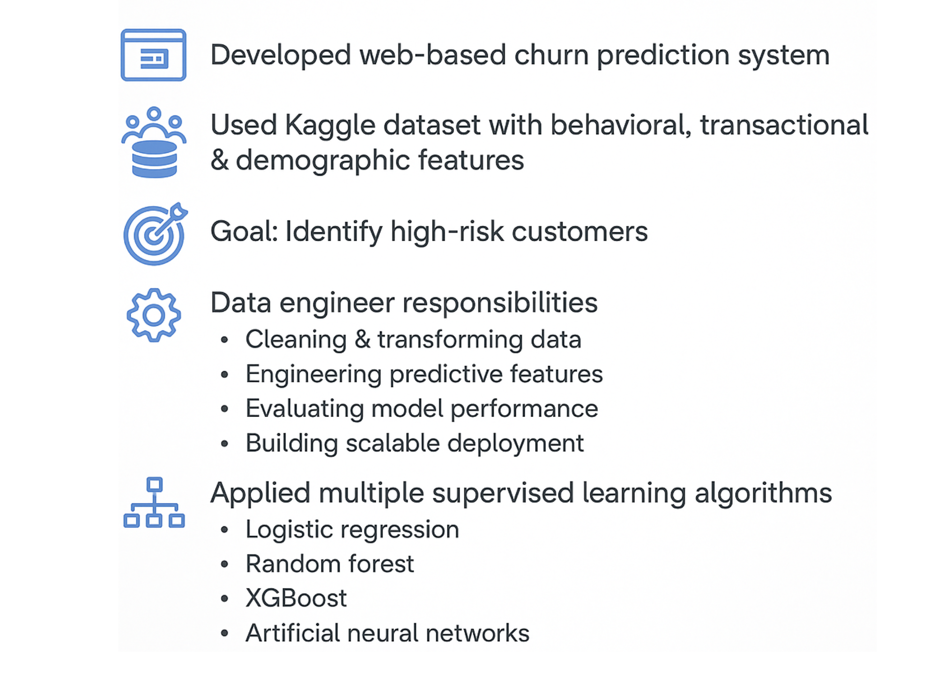
ABSTRACT

Slide 3
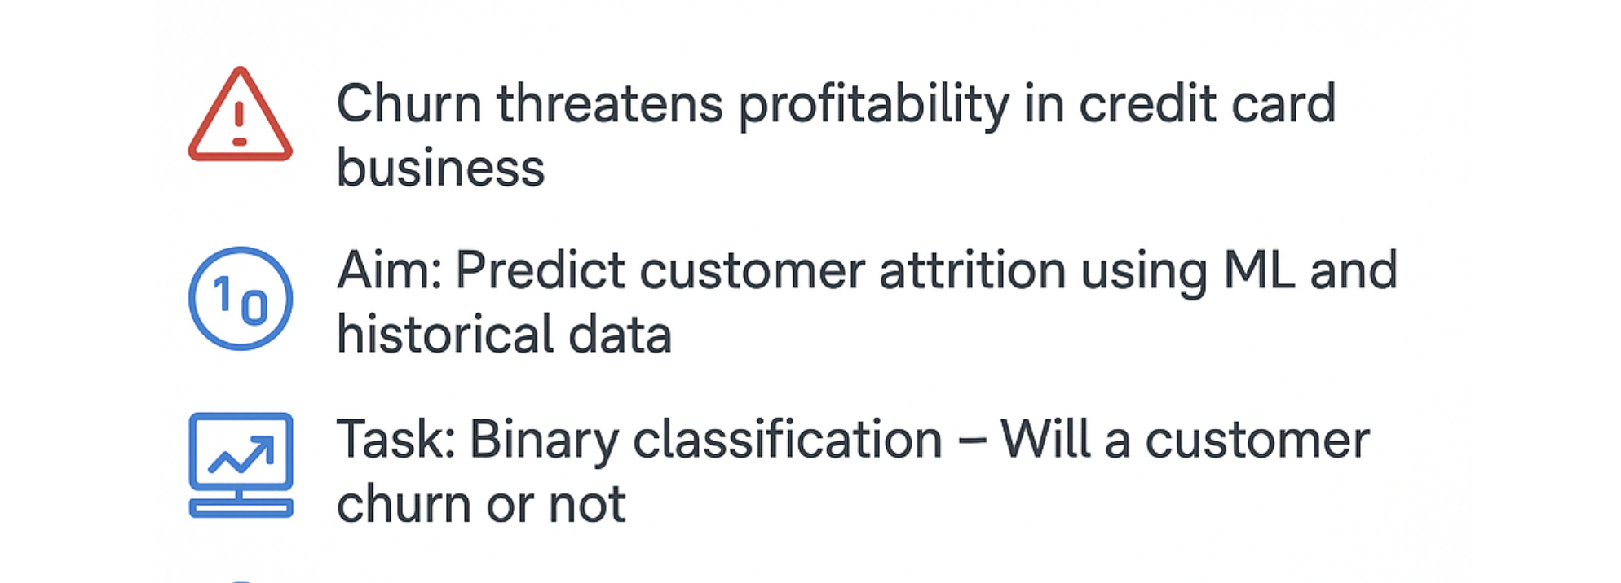
Problem Overview

Slide 4
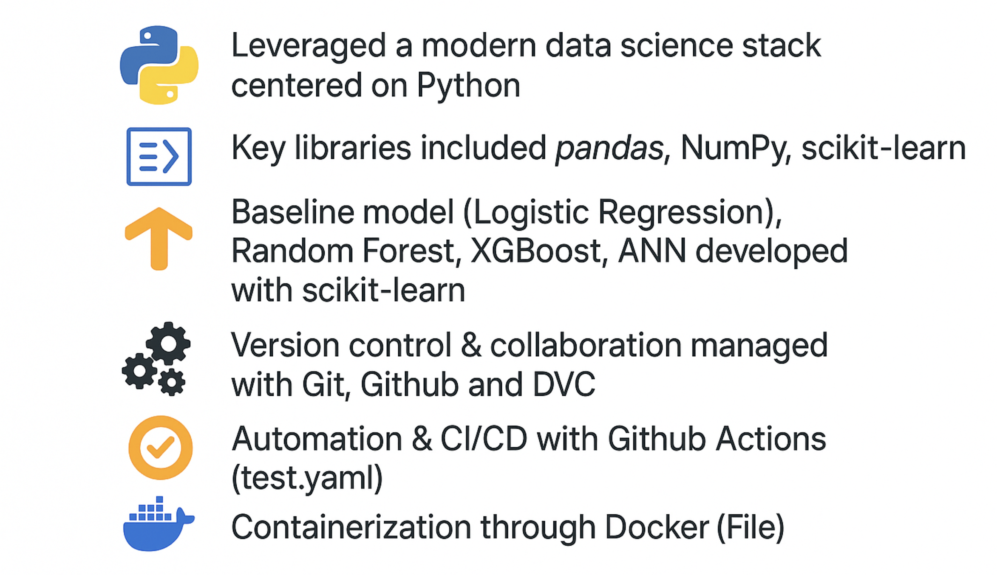
BACKGROUND

Slide 5
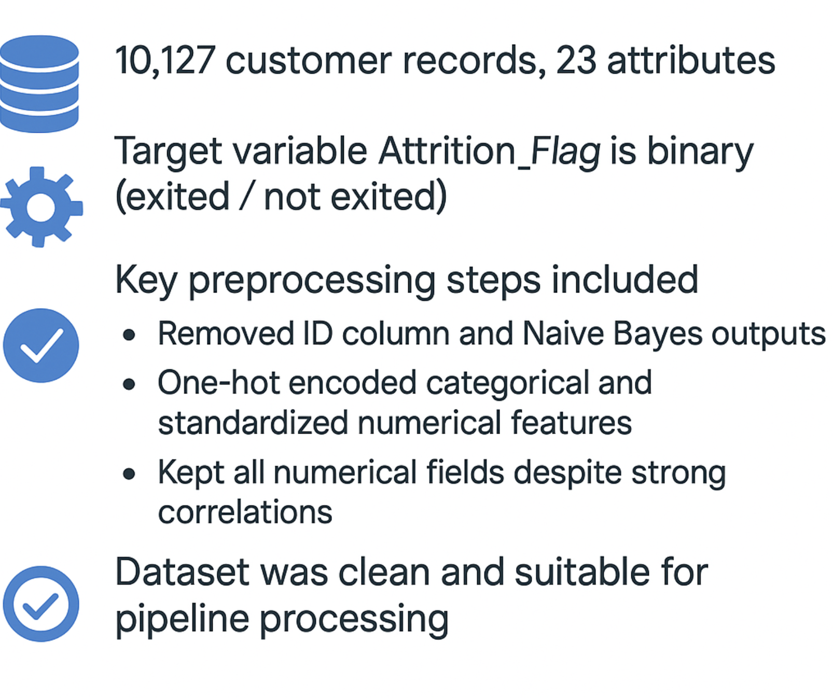
DATASET INFORMATION

Slide 6
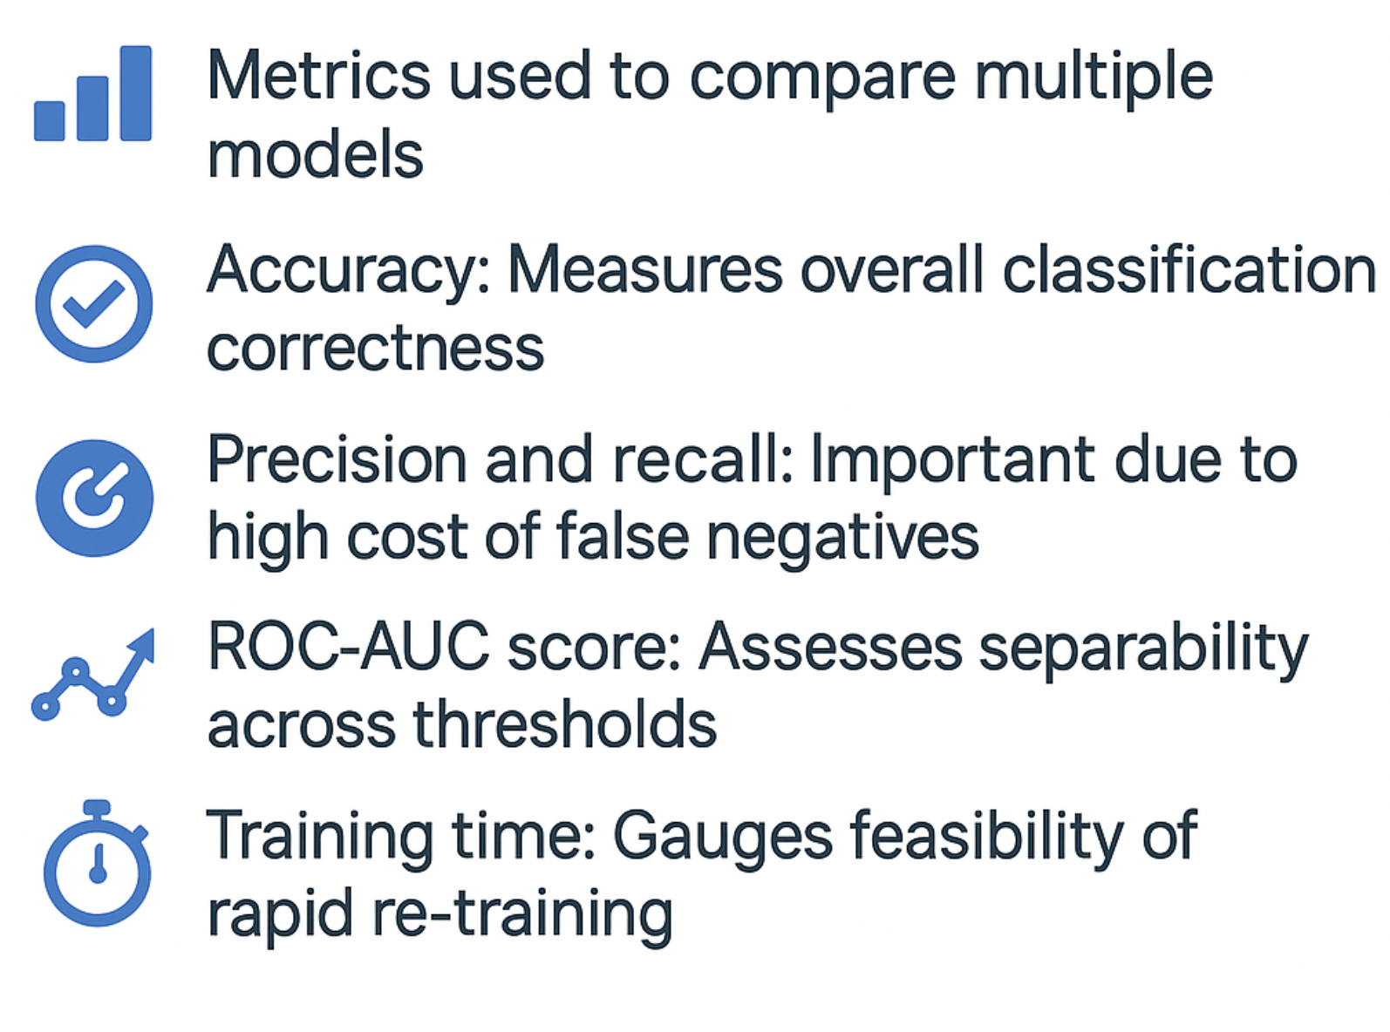
KEY PERFORMANCE INDICATORS

Slide 7
DATA EXPLORATION & STATISTICAL ANALYSIS
Customer Diversity: Customers span a broad range of ages, income levels, and product usage patterns.
High Correlation Observed:
Near-perfect correlation (0.99) between Credit_Limit and Avg_Open_To_Buy
Strong correlations among behavioural features such as:
Total_Trans_Ct, Total_Trans_Amt, Total_Ct_Chng_Q4_Q1
Demographics: Minimal correlation among demographic variables; retained to help ANN model capture non-linear patterns.
Feature Selection Insight: No features were dropped solely due to correlation. Feature combinations were tested during model experimentation to determine optimal predictive performance.

Slide 8
Methodology-Pipeline Overview
Project Objective
Predict customer churn using structured credit card data
Binary classification task: churn (1) or not churn (0)
Pipeline Stages
1.Data Pre-processing:
No missing or duplicate data
Binary encoding: Attrited Customer = 1, Existing Customer = 0
One-hot encoding of categorical variables (drop first category)
Standardization of numerical features with StandardScaler
Pipeline created using ColumnTransformer
32 final features → Split into 80% train / 20% test using stratified sampling
2.Feature Engineering:
Behavioural indicators: Total_Ct_Chng_Q4_Q1, Total_Amt_Chng_Q4_Q1
Usage metric: Avg_Utilization_Ratio
Removed: CLIENTNUM, Naive Bayes features
Retained high-correlation pair: Credit_Limit & Avg_Open_To_Buy
Pipeline kept modular for future engineered features

Slide 9
Methodology – Model Selection & Tuning
Model Training & Comparison
Models used:
Logistic Regression – baseline, fast, basic
Random Forest – improved metrics, interpretable with Feature Importance
XGBoost – best accuracy & F1, handles imbalance
ANN – strong recall & ROC-AUC, slower to train
Evaluation Metrics:
Balanced Accuracy
Weighted F1 Score
Precision & Recall
TP / TN / FP / FN
Specificity, ROC-AUC Score
Training Time
Hyperparameter Tuning
GridSearchCV: for LR, RF, XGBoost (with StratifiedKFold)
KerasTuner: for ANN
Objective metric: Weighted F1 Score
Cross-validated with 5-fold Stratified CV

Slide 10
Discussion & Performance Evaluation
Developed a modular Python pipeline for flexibility and reproducibility
Used scikit-learn ColumnTransformer for scaling and encoding
Stratified sampling ensured class balance in train/test split
Models evaluated:
Logistic Regression (baseline)
Random Forest (stable)
XGBoost (top performer)
ANN (strong non-linear performance)
Persistence:
Classical models saved via joblib in pckl format
ANN saved in .keras format
Evaluation Metrics:
Balanced Accuracy, Weighted F1 Score
Precision, Recall (TPR), Specificity (TNR)
False Positive/Negative Rates, ROC-AUC
Training Time (efficiency indicator)

Slide 11
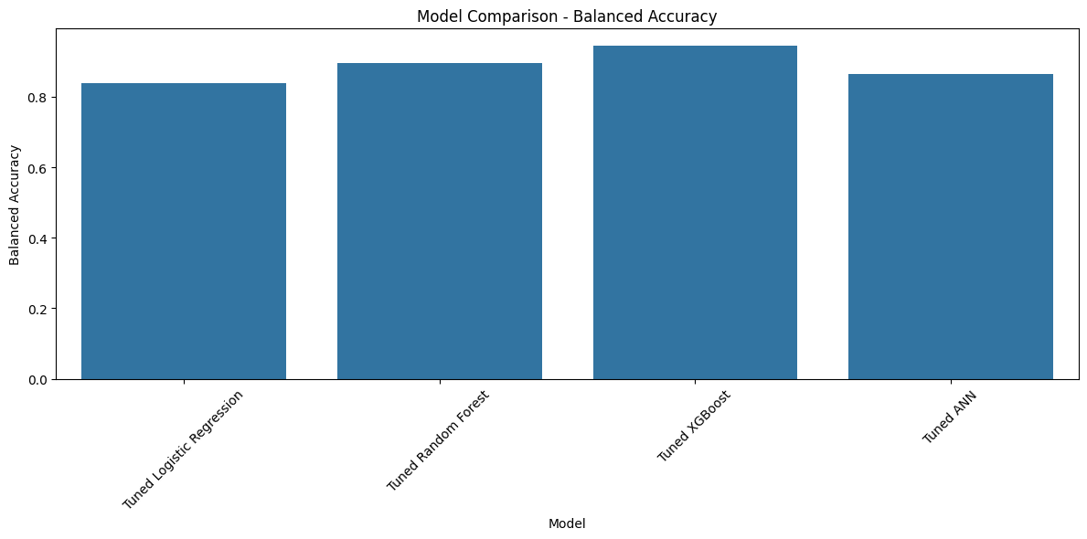
Model Comparison: Balanced Accuracy

Slide 12

Model Comparison: ROC AUC

Slide 13
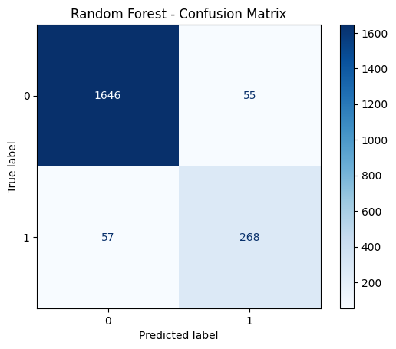
Random Forest - Confusion Matrix

Slide 14
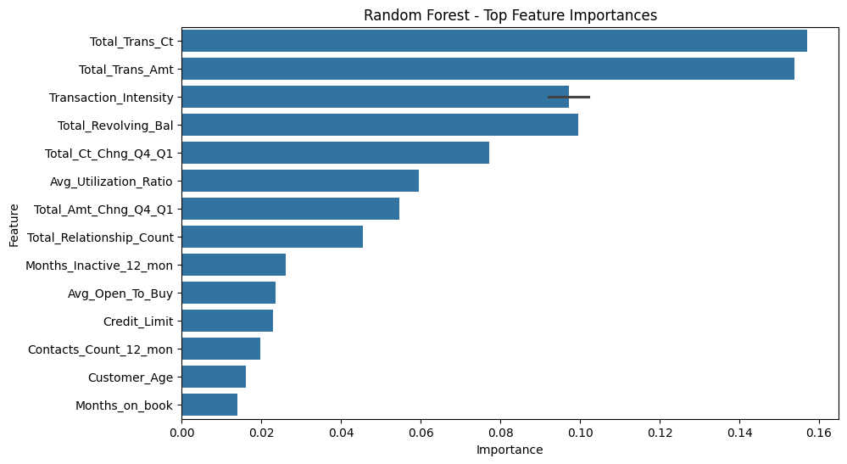
Random Forest - Feature Importances

Slide 15
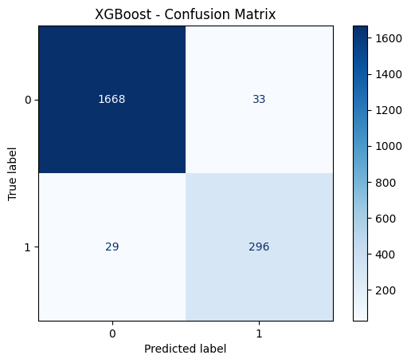
XGBoost - Confusion Matrix

Slide 16
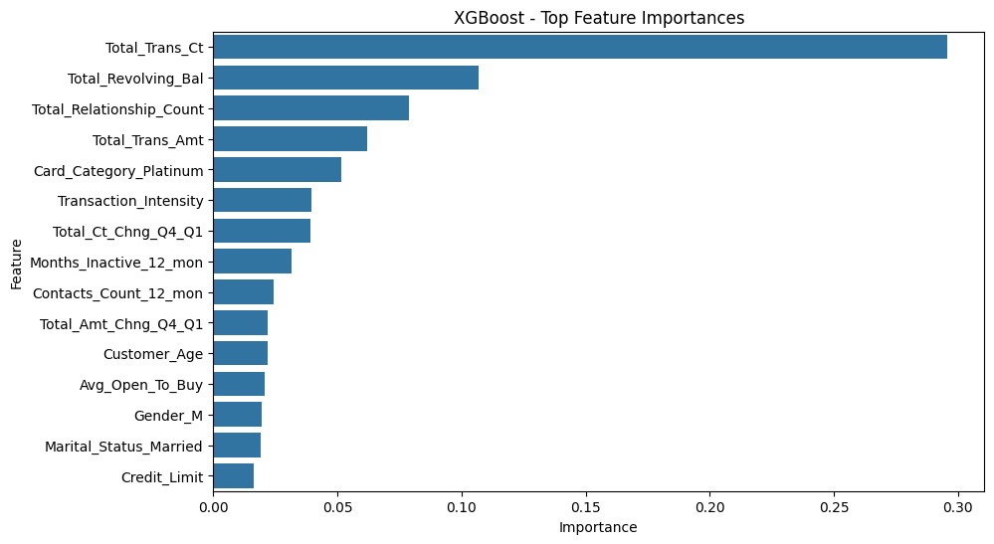
XGBoost - Feature Importances

Slide 17
KEY INSIGHTS
XGBoost: Best across all metrics, fast, robust to class imbalance
ANN: Strong recall & accuracy, slower to train
Random Forest: Balanced, interpretable, stable
Logistic Regression: Fast, simple baseline

Slide 18
Challenges
Data Imbalance
The churn class was underrepresented (~16% attrited vs 84% retained), which made fair model evaluation challenging. Required careful metric selection (e.g., F1, balanced accuracy).
High Feature Correlation
Variables like Credit_Limit and Avg_Open_To_Buy had ~0.99 correlation. Deciding whether to drop or retain correlated features required empirical testing and caution.
Encoding Categorical Variables
Balancing label encoding vs one-hot encoding without causing multicollinearity or high-dimensionality was non-trivial.
Model Reproducibility with DVC
While DVC tracked pre-processing successfully, remote storage integration (e.g., Google Drive) faced OAuth restrictions, limiting full pipeline sharing across collaborators.
Lack of Integrated Experiment Tracking While model metadata (e.g., best parameters, scores, timestamps) was manually logged and saved, the project did not utilize MLflow, Weights & Biases, or other experiment tracking tools.

Slide 19
FUTURE WORK
DVC Remote Integration
Finalize integration with a reliable DVC remote (e.g., S3, SSH server, or verified Google Drive OAuth setup) for true team-level reproducibility.
Advanced Feature Engineering
Introduce derived features (e.g., transaction intensity, balance ratios) and apply domain-specific transformations for improved model signal.
Model Explainability
Integrate SHAP or LIME to explain feature influence on churn prediction and improve trust among business users.
Data Drift Monitoring
Implement real-time monitoring of incoming data statistics to trigger alerts when distribution shifts are detected.
Integrate MLflow for Experiment Management Future versions of the pipeline can incorporate MLflow to: Automatically track model hyperparameters, metrics, training duration, and artifacts,Enable visual comparison of experiments via dashboards, Register and version models for smoother transitions to deployment.

Slide 20
Question Time

Slide 21
Thank you

